Slide 1
The link to the Github repository： https://github.com/zekun-fang/FinalProject Zekun Fang

Slide 2
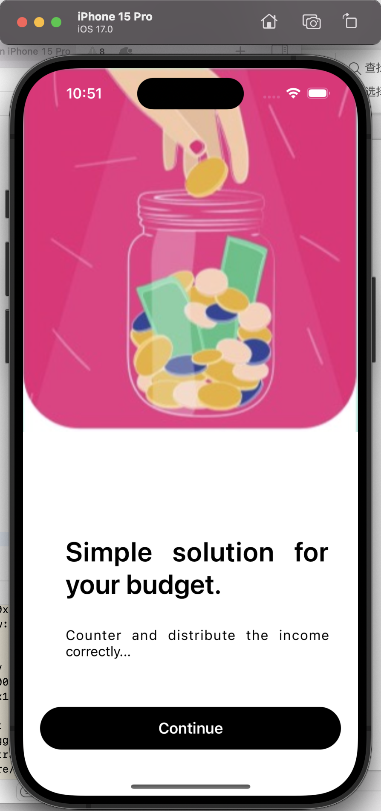
This is the splash screen (welcome screen) of this app, when you click the continue, it will navigate to sign in page.

Slide 3
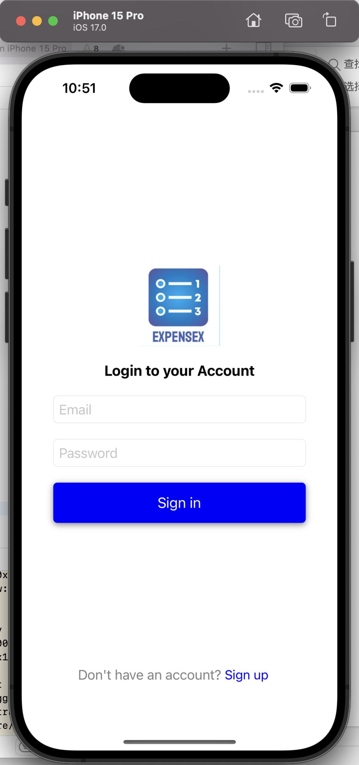
This is the login screen of the app, you can use this screen to sign in or click blue sign up button down there to navigate to sign up screen. When you log in successfully, it will navigate to dashboard screen, which is our main screen.

Slide 4
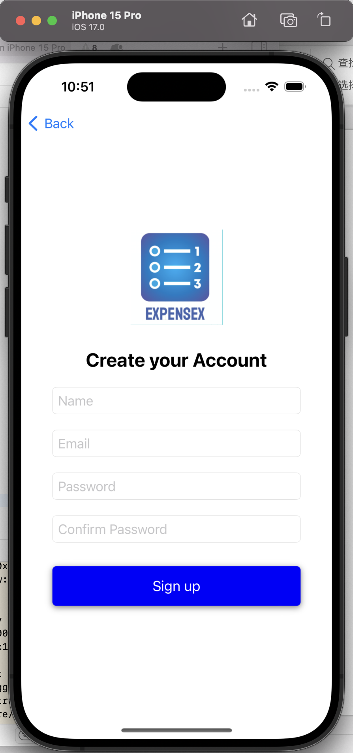
This is sign up screen of the app, you can type in your name, email and password. But here are two password input box, you have to guarantee both are the same so you can go to next screen otherwise it will pop out alert information. All inputbox have input validation here.

Slide 5
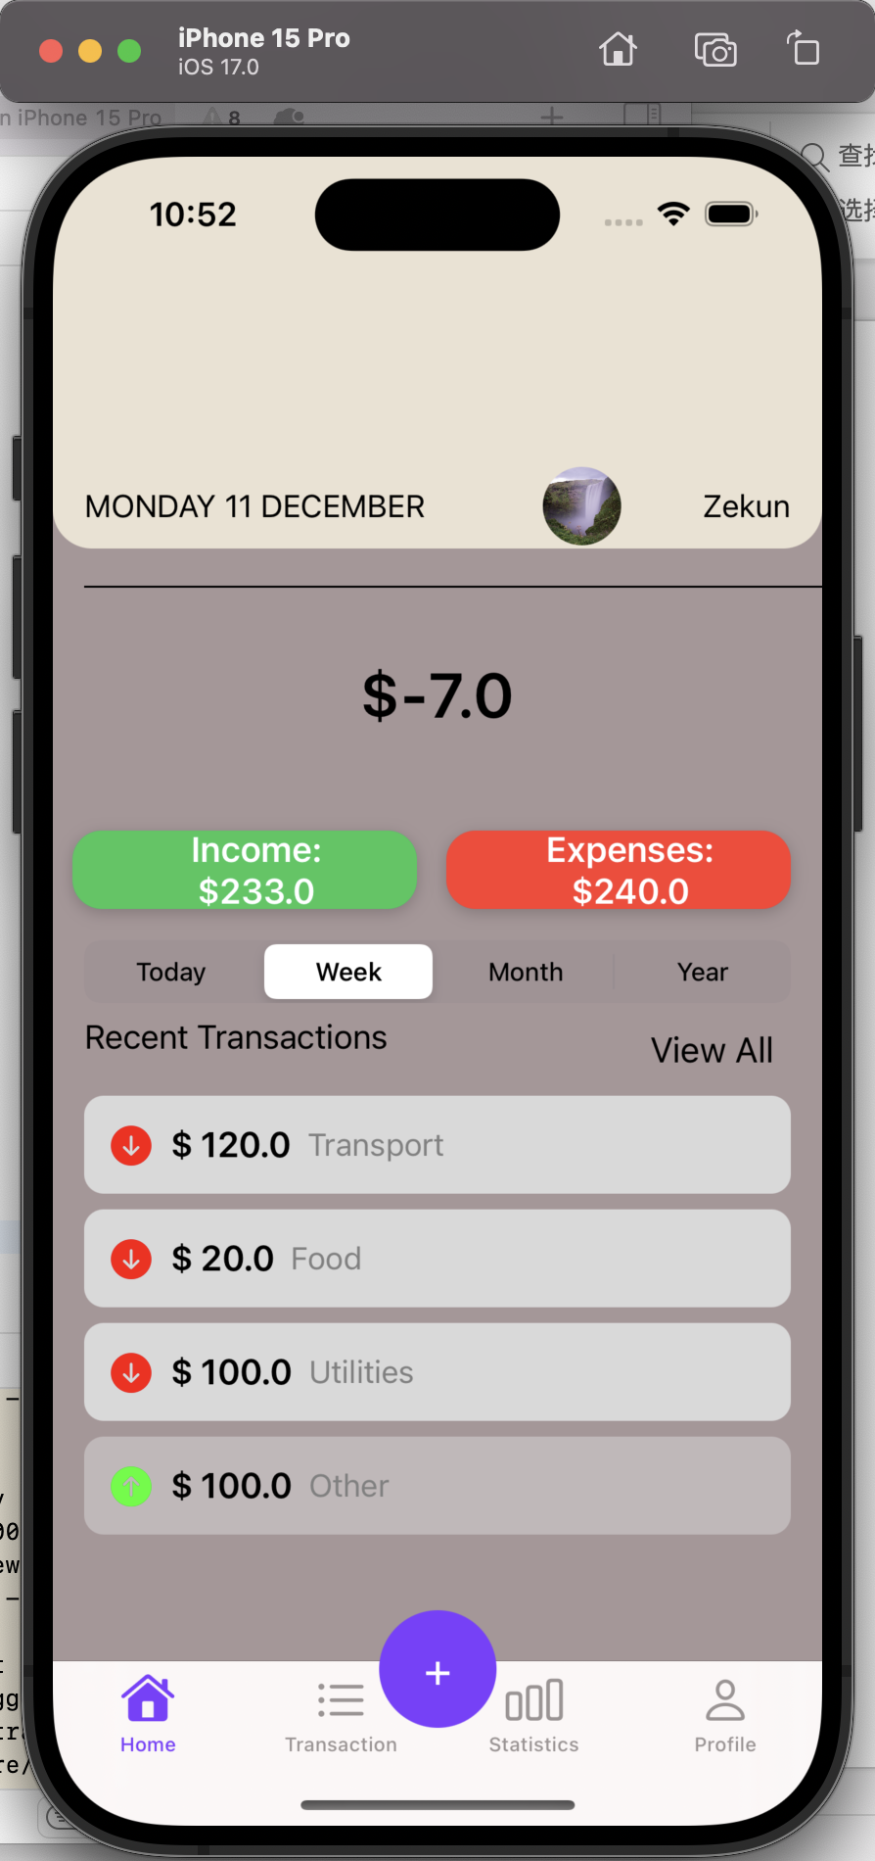
Here’s our main screen, also known as dashboard screen. At the top of the screen, it will show the current date and this date will update over time. Right of the top are avatar image and name of the current user.
Down here a big label shows the current account balance, which will vary as you add diffrent transaction or delete ones.
Income and Expenses label shows the detail of your expense.
Four segment down here, you can choose any one of them to show transactions of today, this week, this month or this year, and you can type view all to check every one of them and details.
At the bottom of the screen, there are four tab bar which navigates to different pages and if you click the plus button, it will navigate to add trasaction screen.

Slide 6
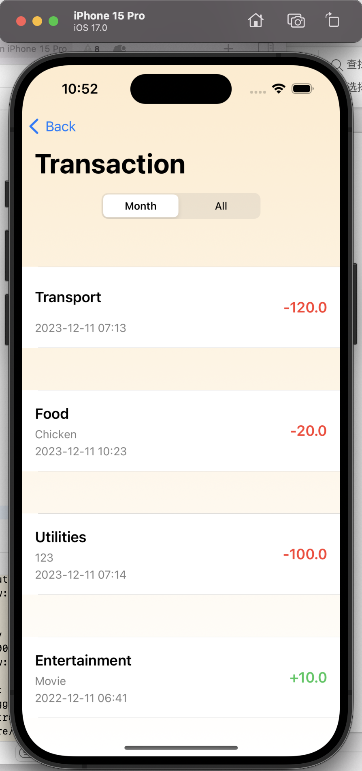
If you chose the trasaction tab bar, here’s what you will see. You will see all the details of each transaction, including category, time, amount and description if it has.

Slide 7
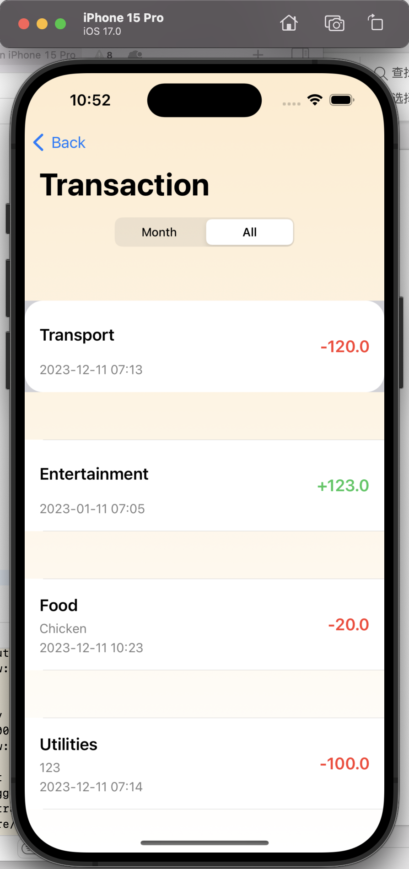
Same as the previous slide but you click “all” segment, it will show you transactions all the time, but previous one only shows those in this month’s.

Slide 8
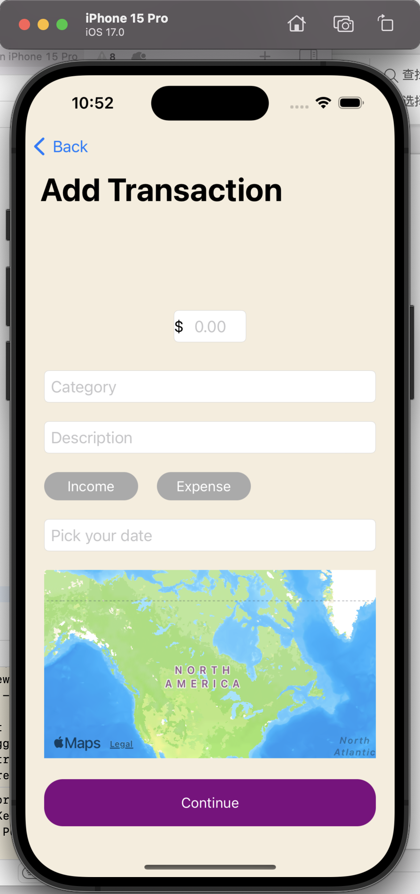
Here’s add transaction screen. You can type in trasaction amount, choose category by wheel, fill in description, and pick your date of this transaction. Finally, you can set the location on the map if you like. When you click “Continue”, it’ll go back to the dashboard screen, and all updates will pop out immediately.

Slide 9
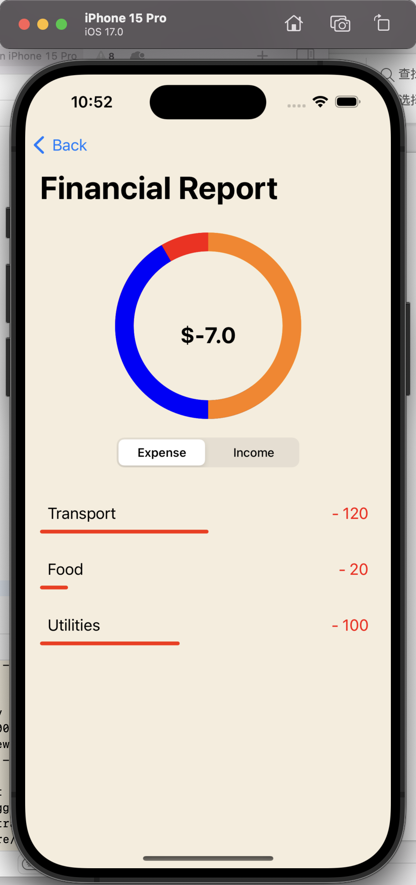
Here comes the most difficult and irritating part.
Statistic page is a crucial component of the app, offering users valuable insights into their financial behavior in an easy-to-understand and visually appealing format. It enhances the user experience by providing a clear and concise overview of financial activities, aiding in better financial planning and decision-making. I use segmented control, progress Ring, progress bar to implment it and it can.
Dynamic Data Handling, Displaying Category Details in the Table View and Updating the Progress Ring are big challenge I met in this part.

Slide 10
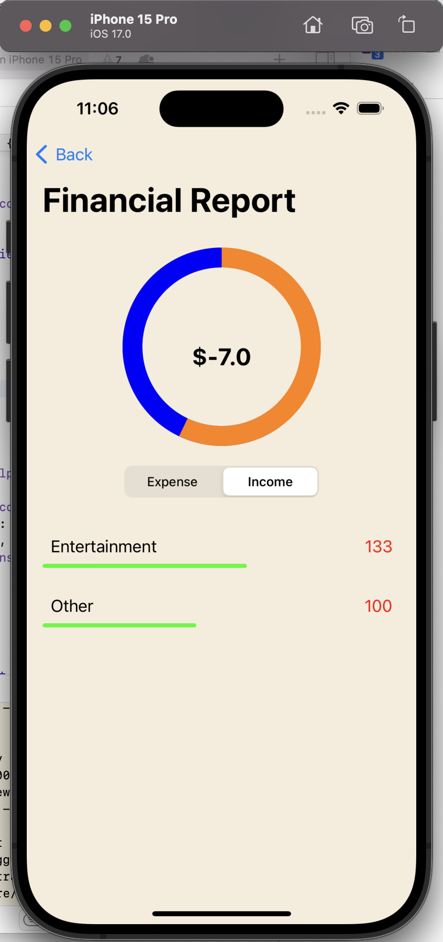
Similiar to previous slide, but you can see I use different color to represent different category and distinguish income and expense.

Slide 11
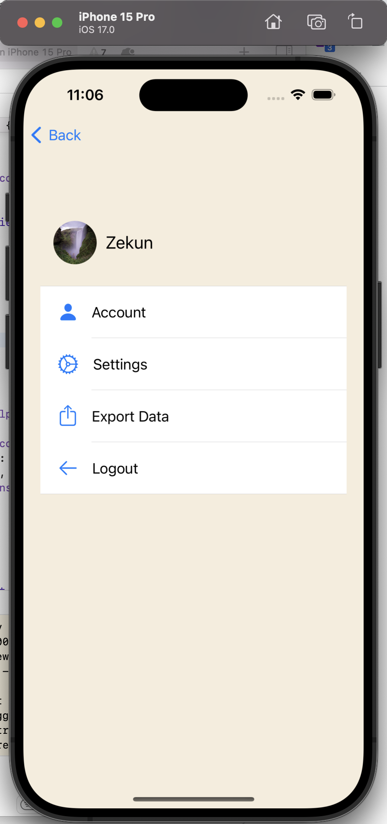
This is profile page, you can find your avatar image and name here. Also you can choose different buttons down there to perform the respective operation. But I’m sorry that I skipped settings and export data because It was a one-man project from start to finish. If I have the chance in the future, I will try different functions to improve my app

Slide 12
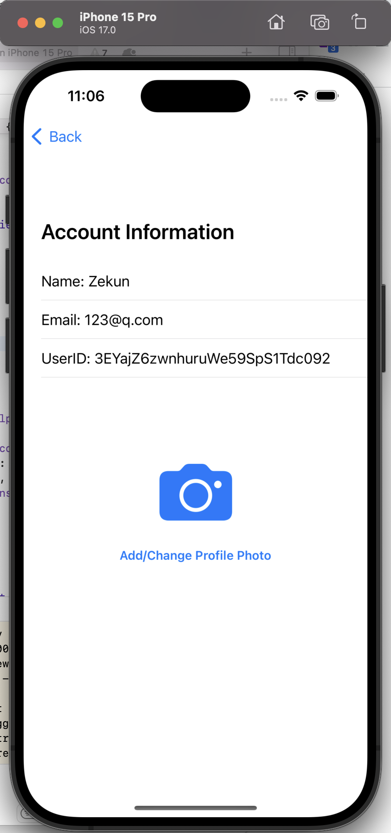
If you click the account button at previous page, you will see this screen. you can tap name to change your name, choose image or take photo to update your profile photo. And it will update dynamically to this page, previous page and dashboard screen.

Slide 13
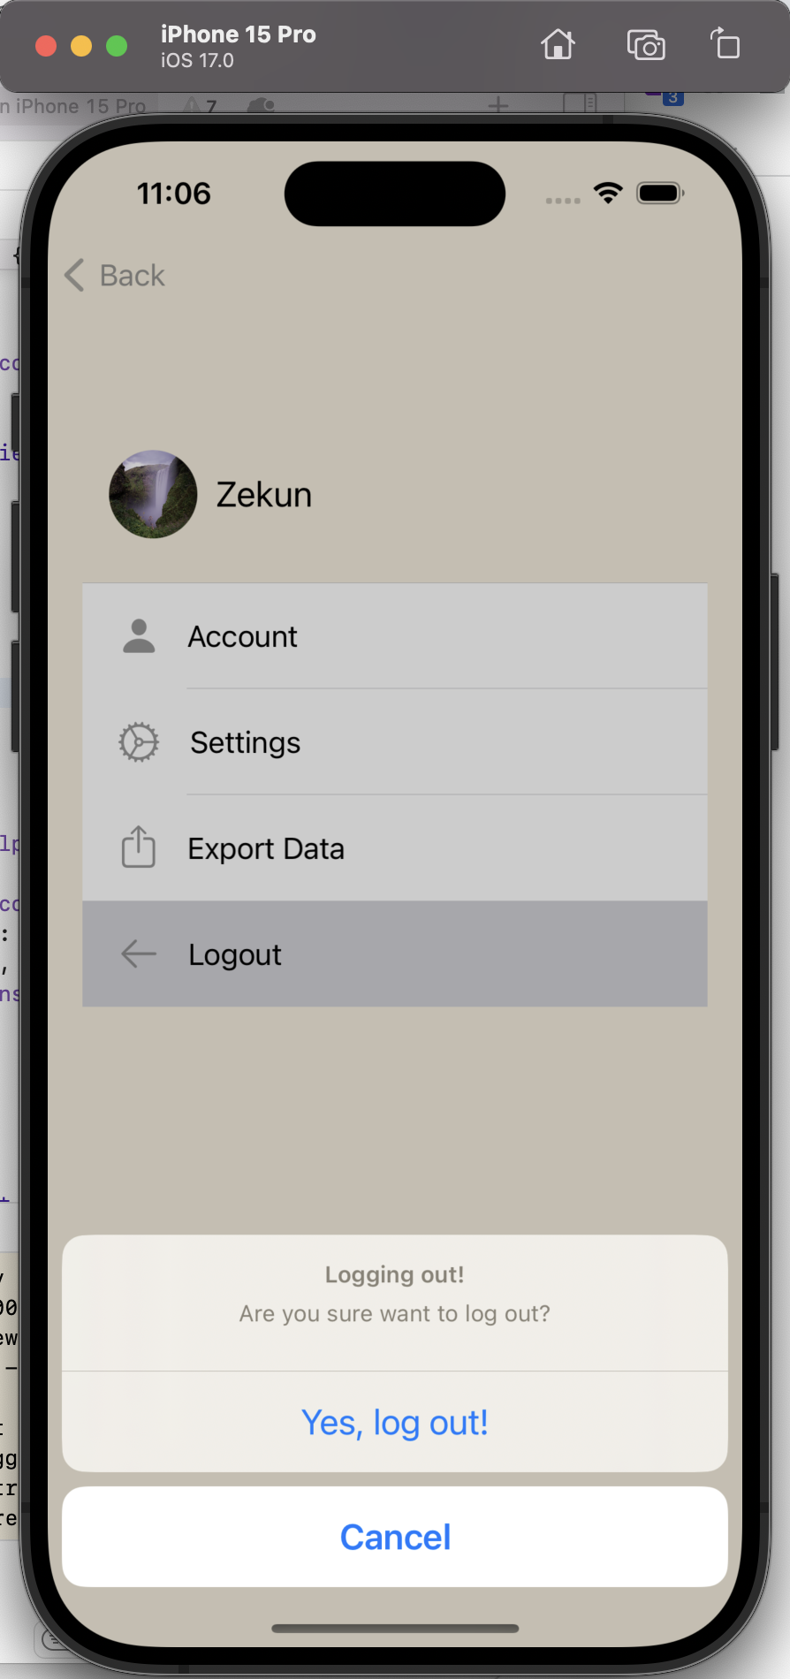
You can log out from this screen, and it will pop the screen and go back to the welcome screen if you like.

Slide 14

Thanks for your effort and commitment
for this course!

